Slide 1
Real-time Air Quality Monitoring and Forecasting
Guided by:
Prof. Mansi Kambli
Built by:
Jay Gala 1611076
Tushar Kadam 1611084
Dhruvi Vadalia 1611115

Slide 2
Problem Definition and Scope

Slide 3
Problem Definition
Using certain air quality sensor APIs, we will detect the levels of particulate matter etc. in real time.
On the basis of data collected, we use data analytical methods to give user real time output about air pollution levels in the area.
We will perform time series forecasting to predict possible level of air pollution.

Slide 4
Scope
To facilitate understanding regarding the effects of pollutants on the environment
To create a portal to gain insight regarding the current levels of pollution
To create an analytics model to show the current trends in air particulate levels
To create a predictive model to predict, with a certain amount of accuracy the level of future pollution.
To generate awareness regarding the current levels of pollution and their effects on the future levels
To help find measures to curb the growing levels of pollution and to curb their harmful effects before the damage is irreversible and to find methods to optimize available resources to achieve these goals

Slide 5
Literature Survey

Slide 6
Literature Survey
After studying various research papers on or related to our problem statement we found the following learnings:
Various architectures used to solve this problem including hybrid architecture.
How complex or simple are these architectures or How do they work?
Which algorithms do they use in it?
How good/accurate are these architectures?
Various statistical, machine learning and deep learning algorithms used for time series forecasting.
Comparison between these algorithms on various parameters such as accuracy, computational complexity, model fitting, robustness, training data required, etc.
Among all algorithms, which are most likely suitable or capable for solving this problem statement with good results?

Slide 7
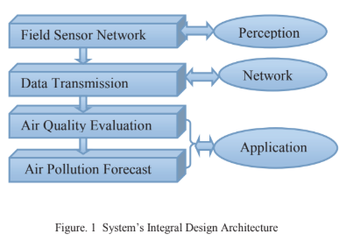
System Architecture
The system is mainly composed of perception layer, network layer and application layer. The system’s integral design architecture is shown in below figure.
[1]

Slide 8
System Architecture
Field Sensor Network: This is part of the perception layer which includes deployment of all sensors in the specific area of which air quality is to be monitored and forecasted.
Data Transmission: This is a part of Network Layer which includes transmission of sensor data collected to cloud for further analysis
Air quality evaluation and forecast: These both are part of the application layer which includes the main components of the project, that is, analysis and forecasting using the Bayesian Regularisation algorithm. [1]

Slide 9
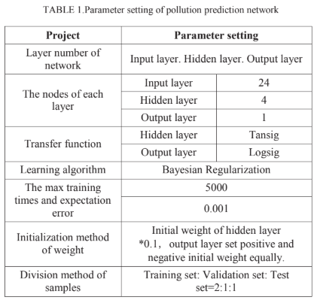
System Architecture
It uses the Bayesian Regularisation algorithm for forecasting purposes with the details shown:
[1]

Slide 10
Hybrid System Architecture
They forecast the reading of an air quality monitoring station over the next 48 hours, using a data-driven method that considers current meteorological data, weather forecasts, and air quality data of the station and that of other stations within a few hundred kilometers. Their predictive model is comprised of four major components:
1) a linear regression-based temporal predictor to model the local factors of air quality,
2) a neural network-based spatial predictor to model global factors,
3) a dynamic aggregator combining the predictions of the spatial and temporal predictors according to meteorological data, and
4) an inflection predictor to capture sudden changes in air quality. [2]

Slide 11
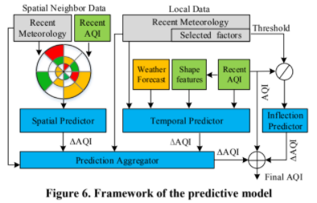
Hybrid System Architecture
[2]

Slide 12
Hybrid System Architecture
The system is based on a framework that connects the cloud with clients, collecting air quality, meteorological data and weather forecasts from over 3,000 sources (e.g. stations/districts/cities) in China. By combining four major components, consisting of temporal predictor, spatial predictor, prediction aggregator, and inflection predictor, their method outperforms four sets of baselines significantly, including the baseline approach using weather forecasting models to predict air quality. In general, their method can achieve an accuracy of 0.75 for the first 6 hours and 0.6 for the next 7-12 hours in Beijing. It predicts the sudden changes of air quality much better than baseline methods. [2]

Slide 13
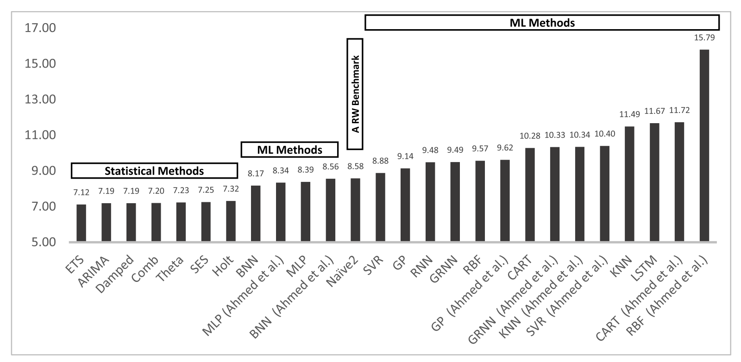
Comparison of various algorithms
The performance (MAPE) of all the algorithms is showed through this picture:
Y-axis: MAPE (Mean Absolute Percentage Error)
[3]

Slide 14
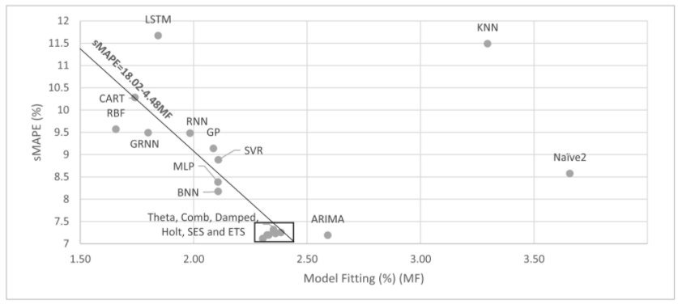
Comparison of various algorithms
[3]

Slide 15
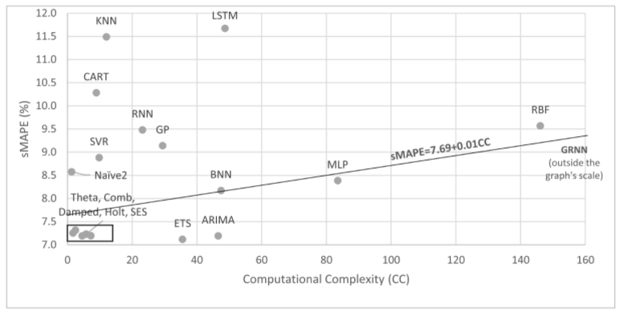
Comparison of various algorithms
[3]

Slide 16
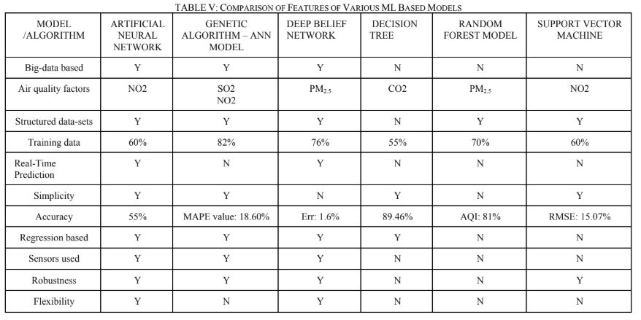
Comparison of various parameters of ML/DL Models for this problem
[4]

Slide 17
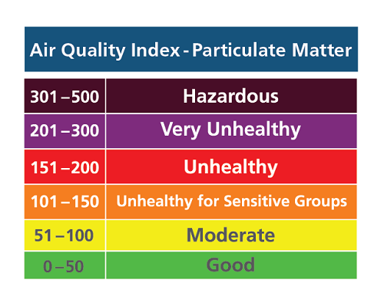
AQI - Air Quality Index Chart
(According to Air Standards given by CPCB)

Slide 18
Literature Survey Inferences
We discovered the important findings of a recent studies evaluating and comparing the performance of classical and modern machine learning methods on a large and diverse set of time series forecasting datasets.
Specifically, we learned:
Classical methods like ETS and ARIMA out-perform machine learning and deep learning methods for one-step forecasting on univariate datasets.
Classical methods like Theta and ARIMA out-perform machine learning and deep learning methods for multi-step forecasting on univariate datasets.
Machine learning and deep learning methods do not yet deliver on their promise for univariate time series forecasting and there is much work to do.

Slide 19
Design of proposed system

Slide 20
Proposed System
From Breezometer API, real-time data is collected on an hourly basis and stored on a cloud file through a python script running on AWS EC2 Instance.
This data is then loaded, processed, transformed and forecasted using various statistical, machine learning and deep learning algorithms on AWS.
The forecasted data is then pushed onto the JSONBin.io in JSON format.
This data is then fetched by the web application to show the results on it in the form of graphs using Chart.js library.
The user can hence see the forecasted data on the website by accessing it.

Slide 21
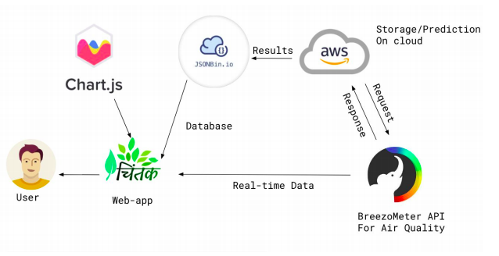
Workflow Diagram

Slide 22
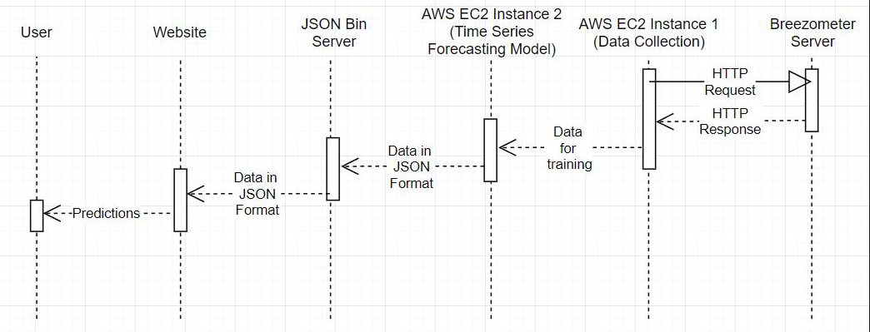
Sequence Diagram
A sequence diagram shows object interactions arranged in time sequence.

Slide 23
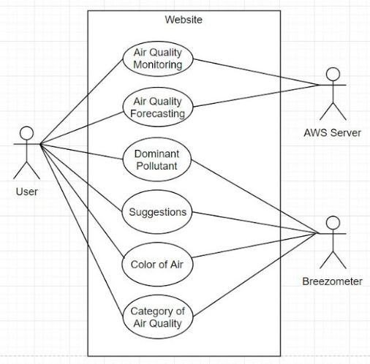
Use Case Diagram
A use case diagram at its simplest is a representation of a user's interaction with the system that shows the relationship between the user and the different use cases in which the user is involved.

Slide 24
Software & Hardware Requirements
Hardware Requirements:
Sensors are deployed by authentic agencies and data collected by these sensors is available free data.gov.in.
Devices for getting live data will fetch it by requesting Cloud Servers where Data is stored.
Software Requirements:
Data will be stored in remote server and data collection will be simultaneously done along with predictions.
Results of Prediction will be fetched from AWS Cloud server.
Note: SRS documentation lists out the requirements in detail

Slide 25
Implementation

Slide 26
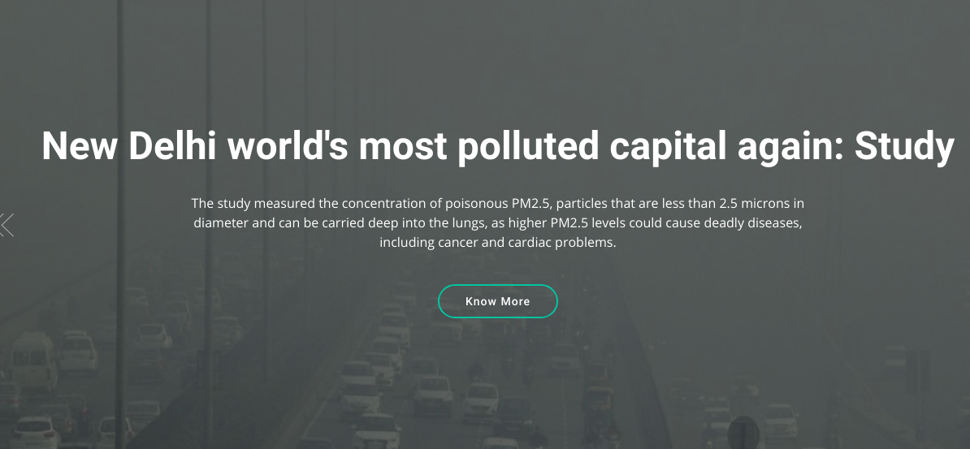
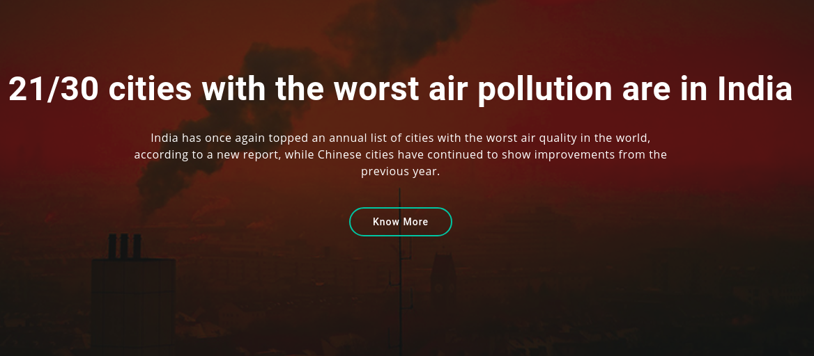
Implementation - Home Page
News Related to Air Quality in your Area

Slide 27
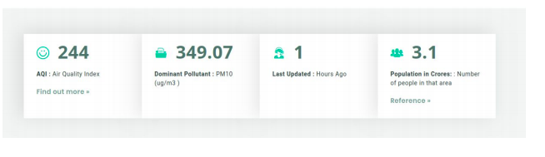
Implementation - Dashboard
Live statistics of Air Quality of given place

Slide 28
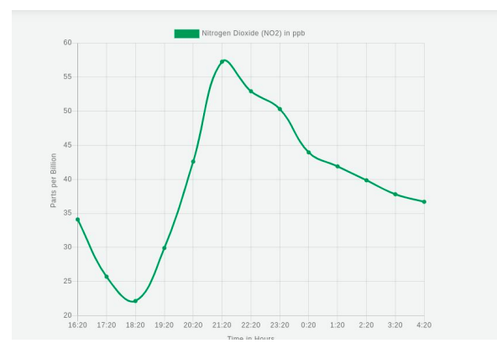
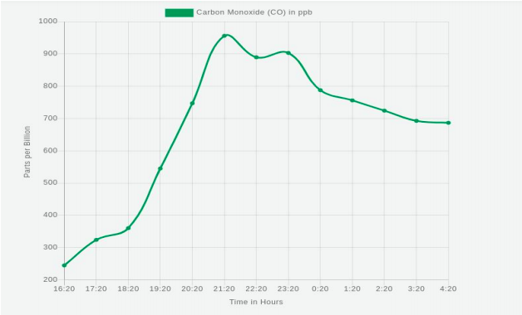
Implementation - Graph/Visualization
Prediction of Concentrations for next 12 hours

Slide 29
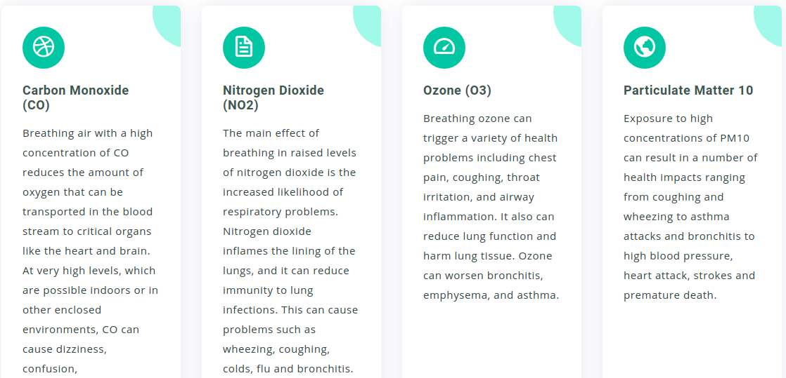
Implementation:
Information about particulates.

Slide 30
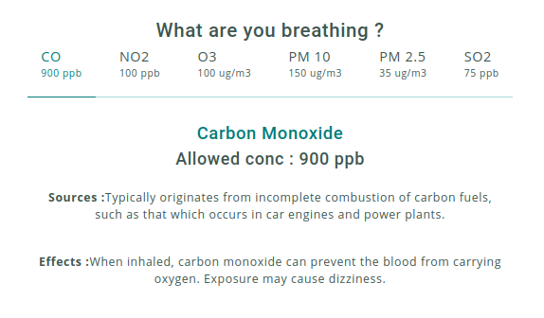
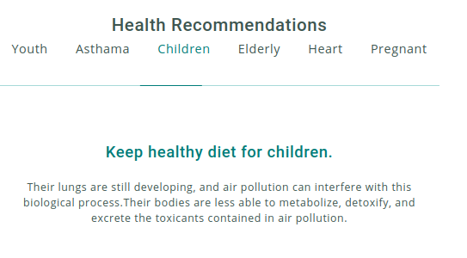
Implementation-Health Recommendations
Exact concentrations of Air particulates

Slide 31
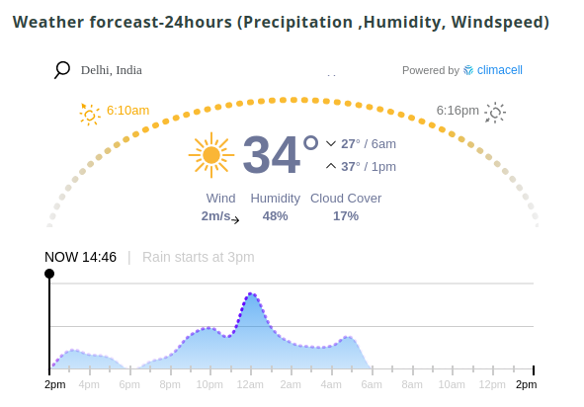
Implementation - Weather Forecast
To help people about weather condition before they go outside

Slide 32
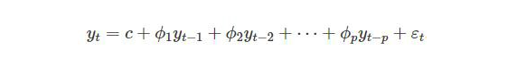
Statistical Models for Time Series :
How they Work ?
ACF is an (complete) auto-correlation function which gives us values of auto-correlation of any series with its lagged values
PACF is a partial auto-correlation function. Basically instead of finding correlations of present with lags like ACF, it finds correlation of the residuals (which remains after removing the effects which are already explained by the earlier lag(s)) with the next lag value hence ‘partial’ and not ‘complete’ as we remove already found variations before we find the next correlation.

Slide 33
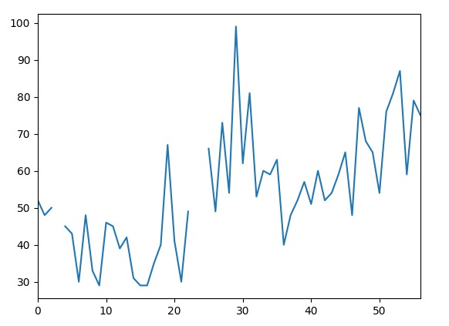
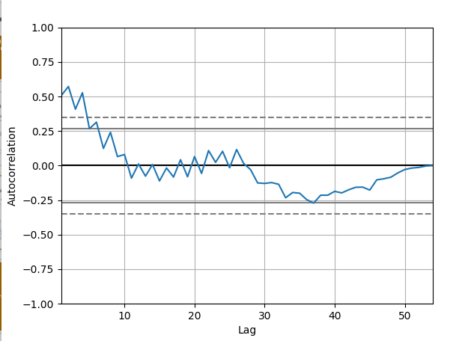
Statistical Models:
ARIMA : Concentration Of CO during diwali
Concentration Of CO
ACF Function of CO

Slide 34
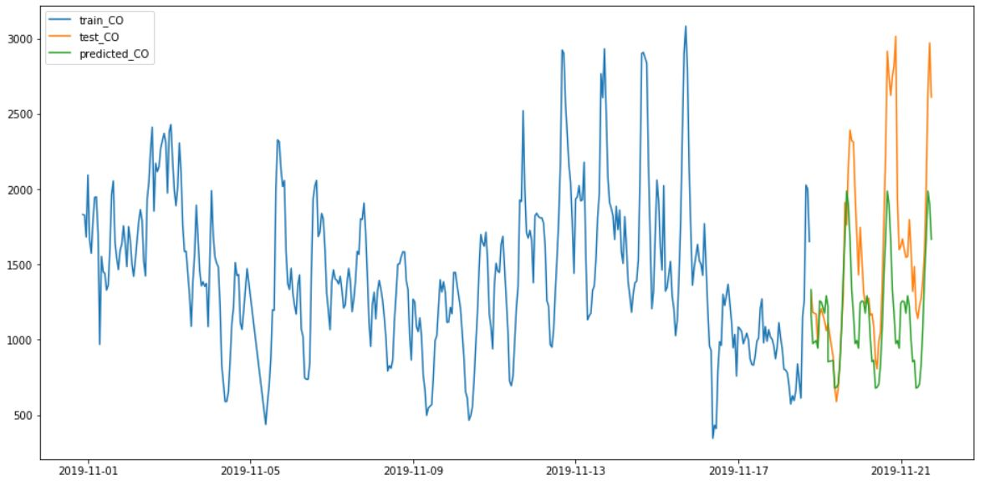
Statistical Models:
Holt-Winters Model :
Location: Delhi MAPE: 23.15

Slide 35
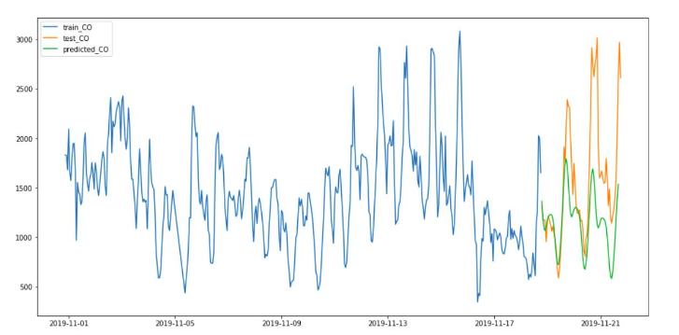
Statistical Models:
ARIMA Model :
Location: Delhi MAPE: 23.84

Slide 36
Research Papers
Citation No. | Research Paper
[1] | “IoT-based Air Pollution Monitoring and Forecasting System " https://ieeexplore.ieee.org/abstract/document/7361361
[2] | “Forecasting Fine-Grained Air Quality based on Big Data” https://dl.acm.org/doi/abs/10.1145/2783258.2788573?casa_token=jLmzvuGW91gAAAAA:Cq2kmw_wriNNnZNEMs0hGBbs-CloTdIFjAAzWgufHYFRWk_WZ7OQVj9ksnKl879cbHI9G2IvHyRZ3A
[3] | “Statistical and Machine Learning Forecasting Methods: Concerns and ways forward” https://journals.plos.org/plosone/article?id=10.1371/journal.pone.0194889
[4] | "Air Quality Prediction: Big Data and Machine Learning Approaches" https://www.researchgate.net/publication/323012727_Air_Quality_Prediction_Big_Data_and_Machine_Learning_Approaches

Slide 37
RNN Description
The idea behind RNNs is to make use of sequential information. In a traditional neural network we assume that all inputs (and outputs) are independent of each other. But for many tasks that’s a very bad idea. If you want to predict the next word in a sentence you better know which words came before it. RNNs are called recurrent because they perform the same task for every element of a sequence, with the output being depended on the previous computations and you already know that they have a “memory” which captures information about what has been calculated so far.
Recurrent neural network (RNN) is a type of deep learning model that is mostly used for analysis of sequential data (time series data prediction). [9]
There are different application areas that are used: Language model, neural machine translation, music generation, time series prediction, financial prediction, etc.

Slide 38
LSTM Description
Long Short-Term Memory (LSTM) networks are a modified version of recurrent neural networks, which makes it easier to remember past data in memory. The vanishing gradient problem of RNN is resolved here.
In an LSTM network, three gates are present:
Input gate — discover which value from input should be used to modify the memory. Sigmoid function decides which values to let through 0,1. and tanh function gives weightage to the values which are passed deciding their level of importance ranging from-1 to 1.
Forget gate — discover what details to be discarded from the block. It is decided by the sigmoid function. it looks at the previous state and the content input and outputs a number between 0 and 1 for each number in the cell state
Output gate — the input and the memory of the block is used to decide the output. Sigmoid function decides which values to let through 0,1. and tanh function gives weightage to the values which are passed deciding their level of importance ranging from-1 to 1 and multiplied with output of Sigmoid.

Slide 39
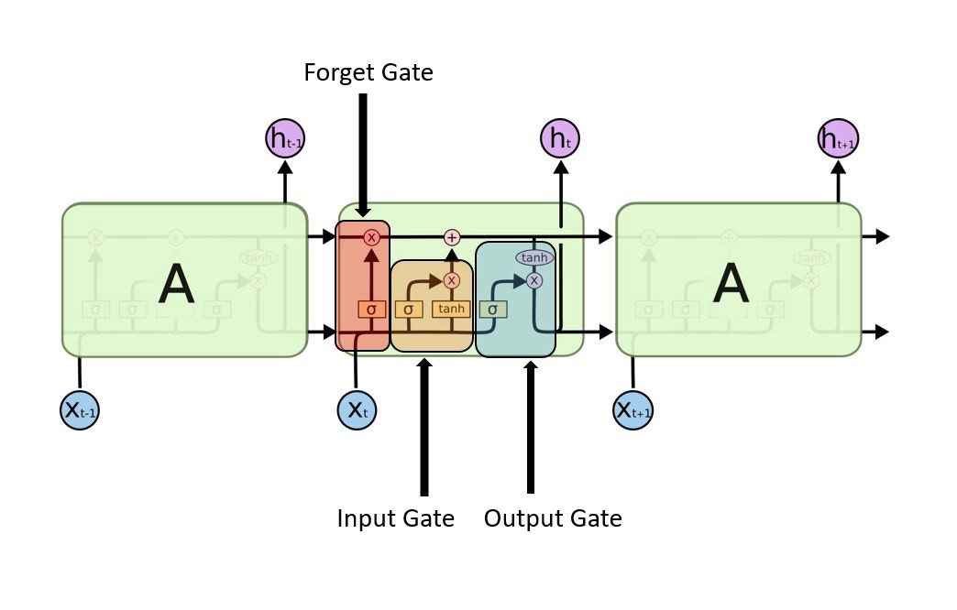
LSTM Working
Gates of LSTM working [8]

Slide 40
RNN LSTM Testing (Univariate)
Scaling | TrainScore (RMSE) | TestScore (RMSE)
MinMaxScaler | 22.58 | 17.58
StandardScaler | 23.75 | 22.23
RobustScaler | 30.78 | 28.94

Slide 41
RNN LSTM Testing (Univariate)
Features | TrainScore (RMSE) | TestScore (RMSE)
Optimizer = Adam | 22.58 | 17.58
Optimizer = SGD | 30.29 | 28.38
Optimizer = RMSprop | 28.57 | 33.27
Learning rate = 0.01, epochs = 15 | 25.86 | 32.75
Learning rate = 0.1, epochs = 10 | 26.72 | 21.35
Learning rate = 0.05, epochs = 30 | 27.43 | 32.35

Slide 42
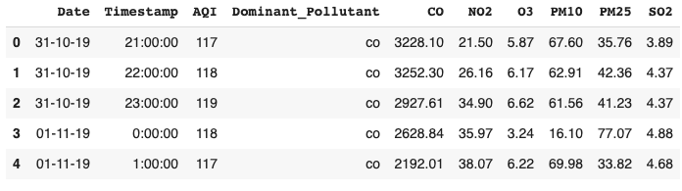
RNN LSTM Data (Tabular)

Slide 43
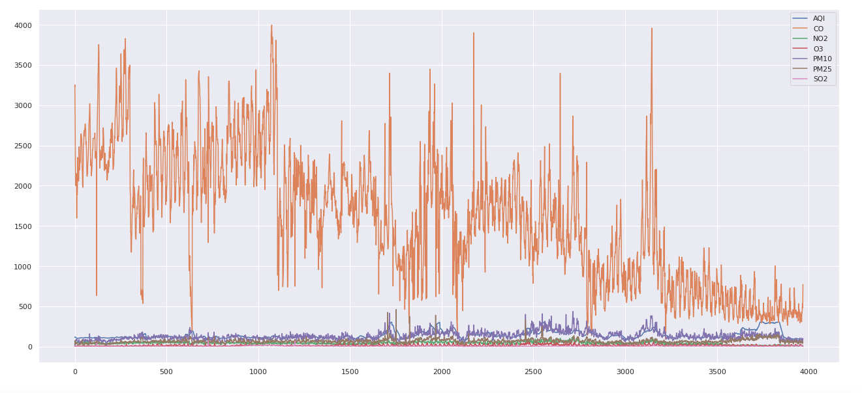
RNN LSTM Data (Graphical)

Slide 44
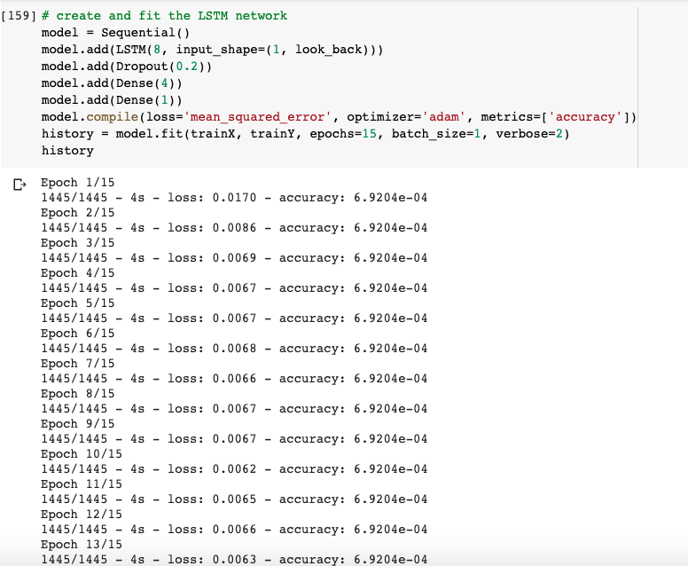
RNN LSTM Model Training (Univariate)

Slide 45
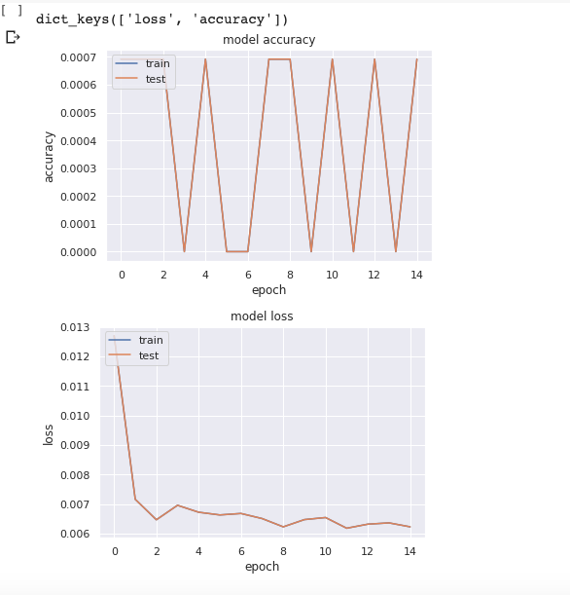
LSTM Model: Output (Univariate)
We train the model for decreasing loss
Here, we can see the model gives higher accuracy than the multivariate model
And the RMSE is pretty low, as we find when we test for accuracy ahead
Hence, we choose the univariate version of the model

Slide 46
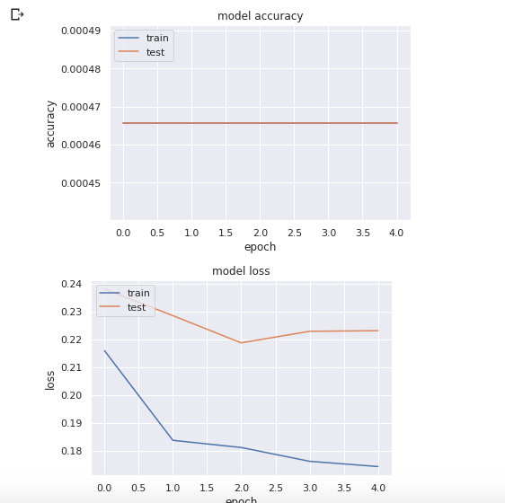
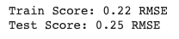
LSTM Model: Output (Multivariate)
Less accuracy due to more variables to be considered
Importance of each variable independent and similar
Univariate a better choice because of higher accuracy, hence multivariate not chosen.

Slide 47
Testing Reports

Slide 48
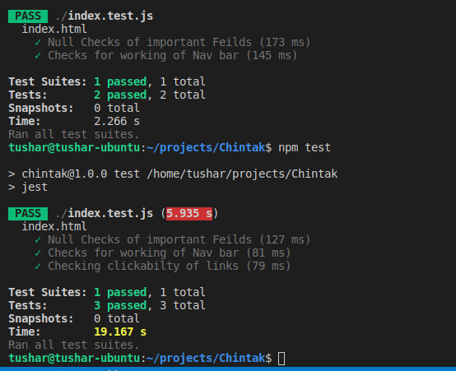
Unit Testing :चिंतक (Web App)
Using Jest framework
Unit tested each of module
Null Checks for links
Link validating checks
Nav-bar working checks
API calls checks

Slide 49
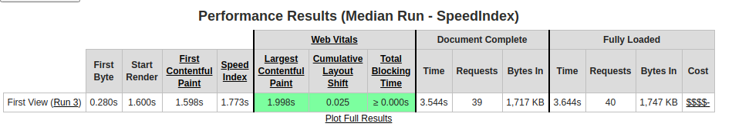
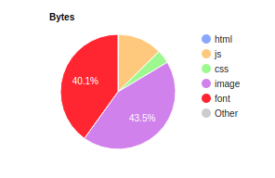
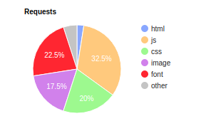
Performance Testing :चिंतक (Web App)
Content Distribution

Slide 50
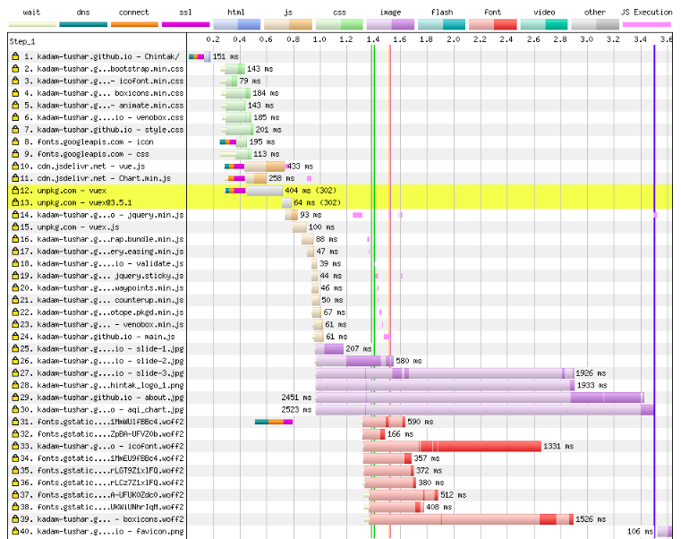
Performance Testing :चिंतक (Web App)
Page Loading Content Wise:

Slide 51
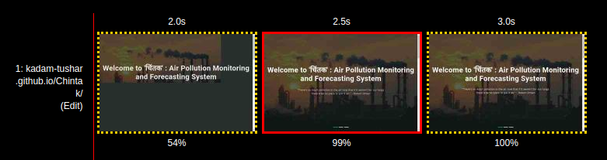
Performance Testing :चिंतक (Web App)
Page Content Time from Visual View

Slide 52
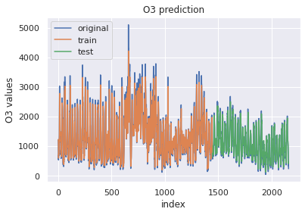
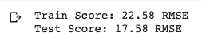
LSTM Model: Output (Univariate)

Slide 53
Limitations

Slide 54
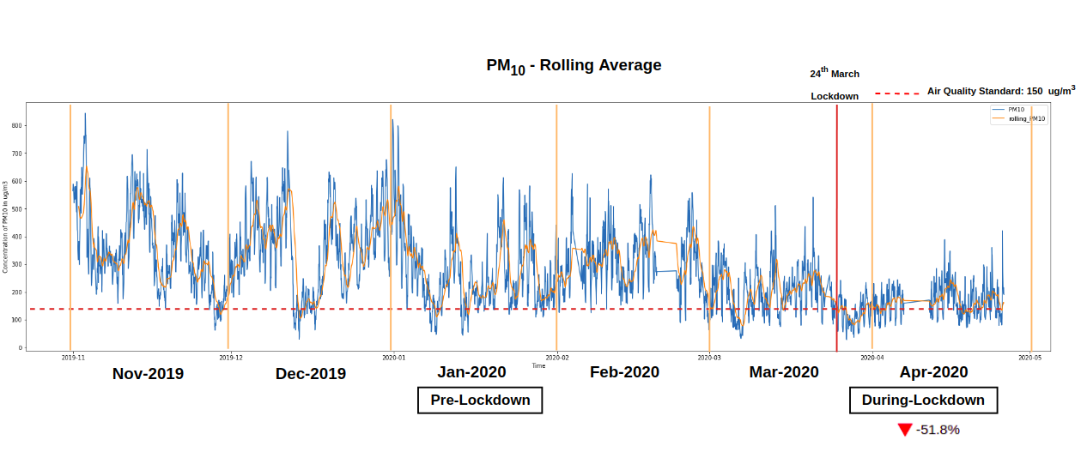
Unpredictable Changes : Covid-19 Impact

Slide 55
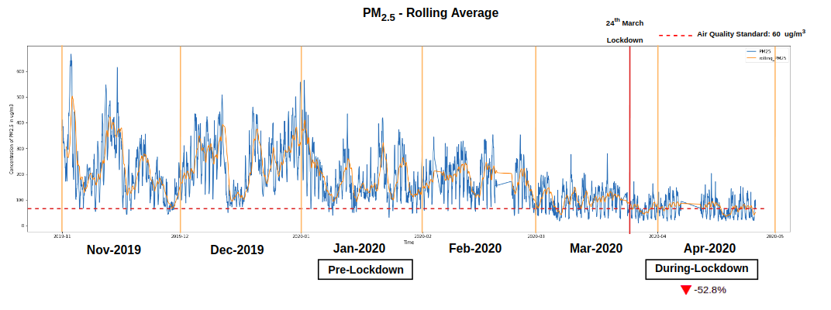
Unpredictable Changes : Covid-19 Impact

Slide 56
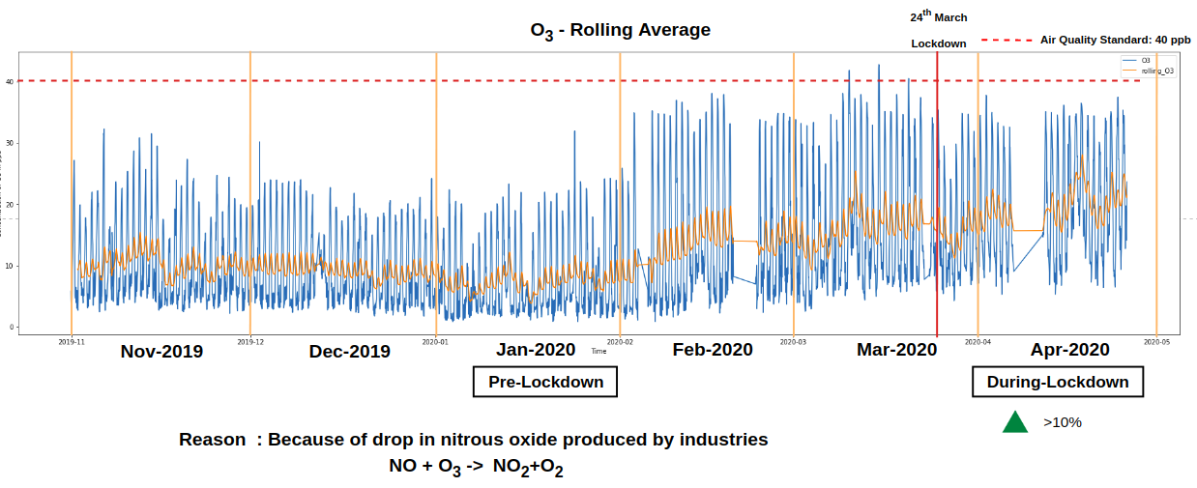
Unpredictable Changes : Covid-19 Impact

Slide 57
Conclusion

Slide 58
Statistical Models
Conclusions for Statistical models :
We can see that the MAPE (Mean Absolute Percentage Error) for all the pollutants is around 22-25
Models like ARIMA, Prophet, Holt Winter’s observe seasonality, trend, stationarity and then predict the results for the next 48 hours.

Slide 59
RNN LSTM (univariate)
Conclusions for RNN LSTM:
We can see that the RMSE (root mean squared error) for all the pollutants is very low
This bodes well for the model, since this implies high accuracy
But, this could also mean that the model has been overfit to this dataset
We tried various parameters for the model, this revealed that for optimizer adam, learning rate 0.05, epochs 15 and MinMaxScaler for the data, we get the best accuracy results, and running a cross-validation check eliminates the possibility of overfitting
Hence, this model can be used for the data we receive to predict the future values

Slide 60
Future Scope

Slide 61
Future Scope
The project applies only the basic analytical devices on the data, such as finding the largest pollutant and hence finding the best precaution to take in such conditions, this project can further be extended to perform higher analytical tasks such as the best approach to reduce the pollutant quantity in the atmosphere and the possible health risks it poses if such measures aren’t taken.
Such analyses require a higher amount of data requirements and from varied, expert sources such as health officials, scientists, meteorologists etc.
The web dashboard could be converted to a software and/or mobile application offering the user an offline functionality as well.
The system could be extended for usage by governments to monitor current conditions and to enforce the restrictions or measures necessary to curb the growing pollutant levels as needed.

Slide 62
References

Slide 63
Research Papers
Citation No. | Research Paper
[5] | “Real-time Air Quality forecasting, part 1: History, techniques and current status” https://www.sciencedirect.com/science/article/abs/pii/S1352231012005900
[6] | “Real-time Air Quality forecasting, part 2: State of the science, current research needs and future prospects” https://www.sciencedirect.com/science/article/abs/pii/S1352231012001562
[7] | "An Empirical comparison of machine learning models for time series forecasting” https://www.tandfonline.com/doi/abs/10.1080/07474938.2010.481556
[8] | “Evaluation of Statistical and Machine Learning models for time series prediction: Identifying the state-of-the-art and the best conditions for the use of each model” https://www.researchgate.net/publication/330742498_Evaluation_of_statistical_and_machine_learning_models_for_time_series_prediction_Identifying_the_state-of-the-art_and_the_best_conditions_for_the_use_of_each_model

Slide 64
Blogs
Citation No. | Research Paper
[9] | “Comparing Classical and Machine Learning Algorithms for Time Series Forecasting” https://machinelearningmastery.com/findings-comparing-classical-and-machine-learning-methods-for-time-series-forecasting/#:~:text=Comparing%20the%20performance%20of%20all,previous%20similar%20studies%20and%20competitions.
[10] | Understanding RNN and LSTM https://towardsdatascience.com/understanding-rnn-and-lstm-f7cdf6dfc14e
[11] | Time Series Prediction using RNN LSTM https://machinelearningmastery.com/time-series-prediction-lstm-recurrent-neural-networks-python-keras/
[12] | ARIMA Model Python example - Time Series Forecasting https://towardsdatascience.com/machine-learning-part-19-time-series-and-autoregressive-integrated-moving-average-model-arima-c1005347b0d7

Slide 65
Questions?

Slide 66
Thank you!!!

